Slide 1
ALIGNING MEDIA THROUGH data: how to tell a compelling story
Jane MacKillop, Associate Dean
Francesca Fiore, Assistant Dean
Heather Barikmo, Instructional Technology Coordinator

Slide 2
ABOUT LAGuardia Community College (CUNY)
Housed in four former factory buildings across the 59th Street Bridge
19,000 undergraduates
29,000 non-credit students
111 languages spoken
157 countries
7 train
Notes:
Jane
Where is LaGuardia? Not the airport, Western Queens, close to Manhattan, built on a busy boulevard by the railway yards in former factory buildings Gives new meaning to the word gritty.
In 2007 we discovered etc.

Slide 3
TELLING A COMPELLING STORY
Who is your market?
Line up your ducks
Decide on your story
Use data for decision-making
Choose your media (two case studies)
A picture is worth a thousand words
Your next steps

Slide 4
Continuing education
Students come in all shapes and sizes – tailor your marketing.

Slide 5
Resources
We know resources can be in short supply, but we still see value in spending them.
TIME,
MONEY
VALUE

Slide 6
Catalog is an umbrella
Marketing stems from the catalog and builds on it.
Notes:
This is the big picture. For example, a single page about high school equivalency programs has links to each program website, QR codes take the reader to the appropriate web page, each page has the division’s phone number, travel directions are clear

Slide 7
YOUR CATALOG SHOULD:
be attractive, clear and comprehensive.
tell stories.
use white space.
use visuals.
use QR codes.
Notes:
Click on catalog image to navigate the web version of the catalog.

Slide 8
Catalog
Website
E-blasts
Google AdWords
Social Media
Notes:
Low actual dollar cost, high cost in time. Francesca and Heather will talk about these. Hand over to Francesca.

Slide 9
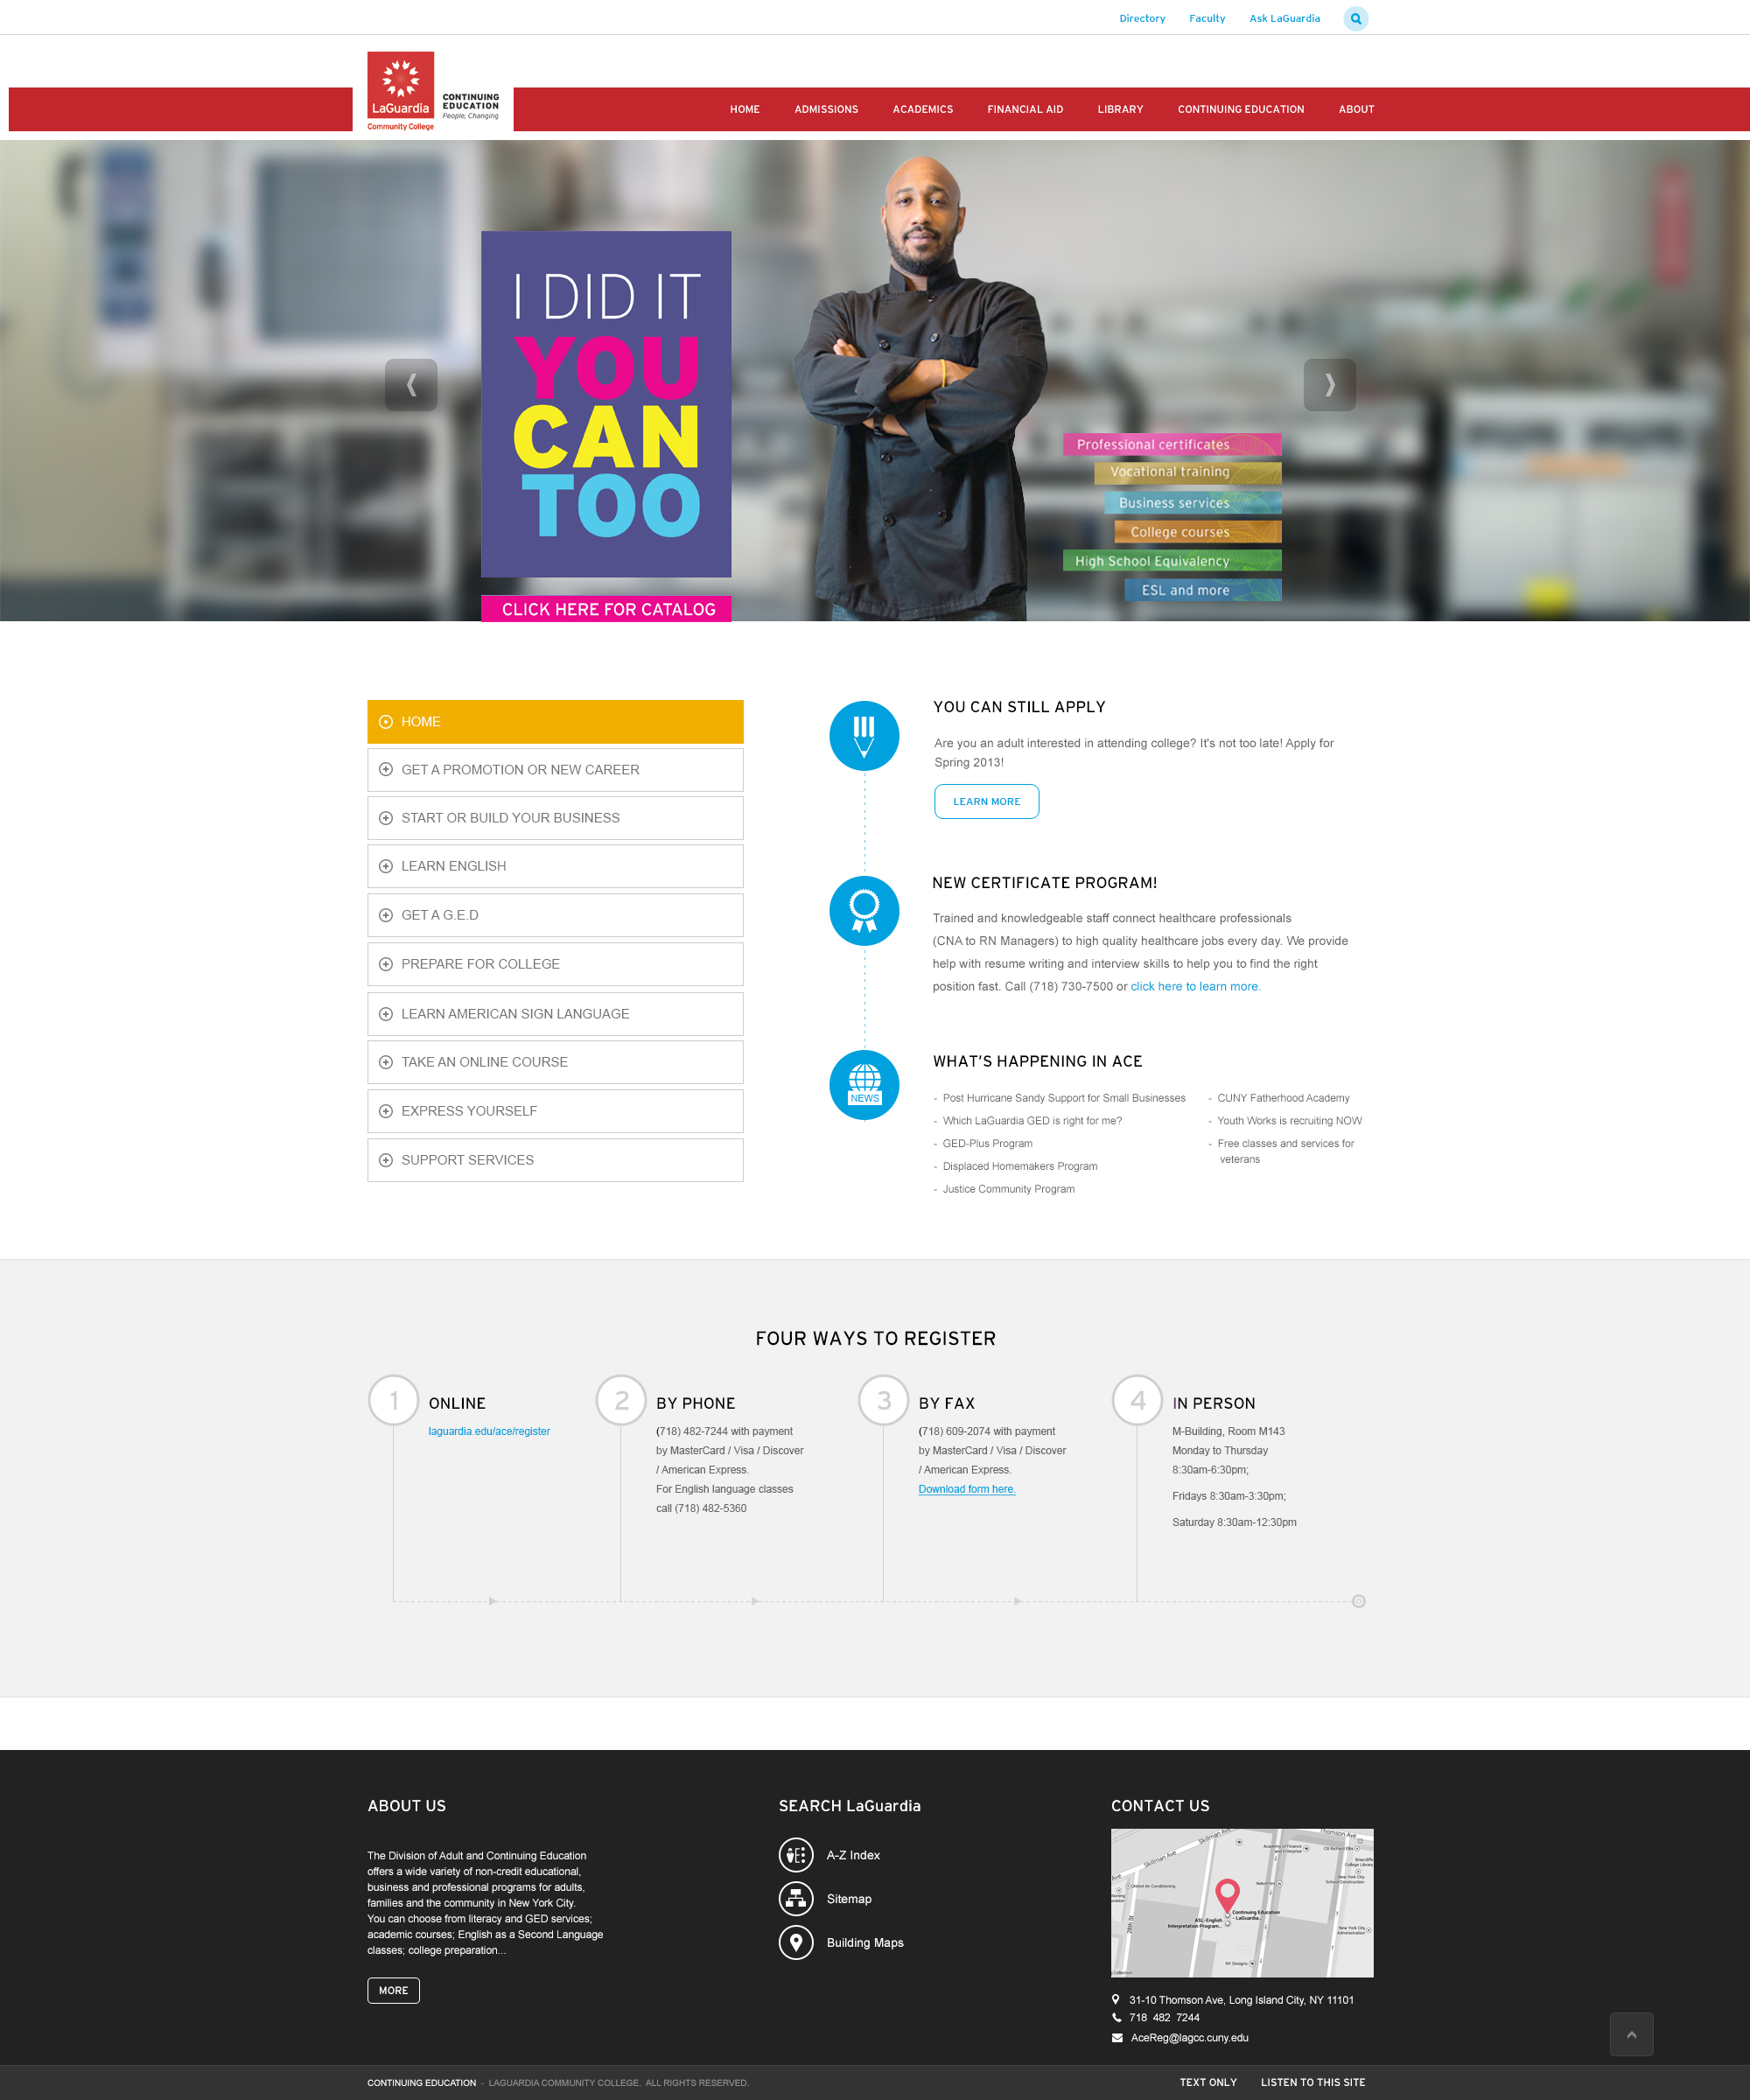

Slide 10
Decide what your unique selling point is.
Location? Price? Choice of courses? Accessibility?
Notes:
LaGCC is urban, part of the community, accessible, unpretentious (we’re four former factory buildings, somewhat linked and we have six trees). It helps to know your audience(s).

Slide 11
DATA-DRIVEN MARKETING
Surveys
Focus Groups
Google AdWords and Search Engine Optimization (SEO)
Google Analytics
Labor Market Information
Notes:
Weill Cornell story
Ad words campaigns – how they work, what we learn from them, what they cost, what is the ROI
Weill Cornell story

Slide 12
SURVEYS & FOCUS GROUPS
STUDENTS: | How did you hear about us?
 | Why are you taking this course?
EMPLOYERS: | Are we targeting the right audience?
 | Are we describing the training properly?
 | Do we have a clear understanding of post-training opportunities?
Notes:
Weill Cornell story
Ad words campaigns – how they work, what we learn from them, what they cost, what is the ROI
Weill Cornell story

Slide 13
ADWORDS, SEARCH ENGINE OPTIMIZATION & ANALYTICS
AdWords and Search Engine Optimization drive traffic to your site.
Analytic tools to measure traffic to your site include:
Growth In Visitors (organic vs. paid)
Bounce Rate (how long visitors stay on a page)
Market Segments (geography, traffic sources)
Notes:
Weill Cornell story
Ad words campaigns – how they work, what we learn from them, what they cost, what is the ROI
Weill Cornell story

Slide 14
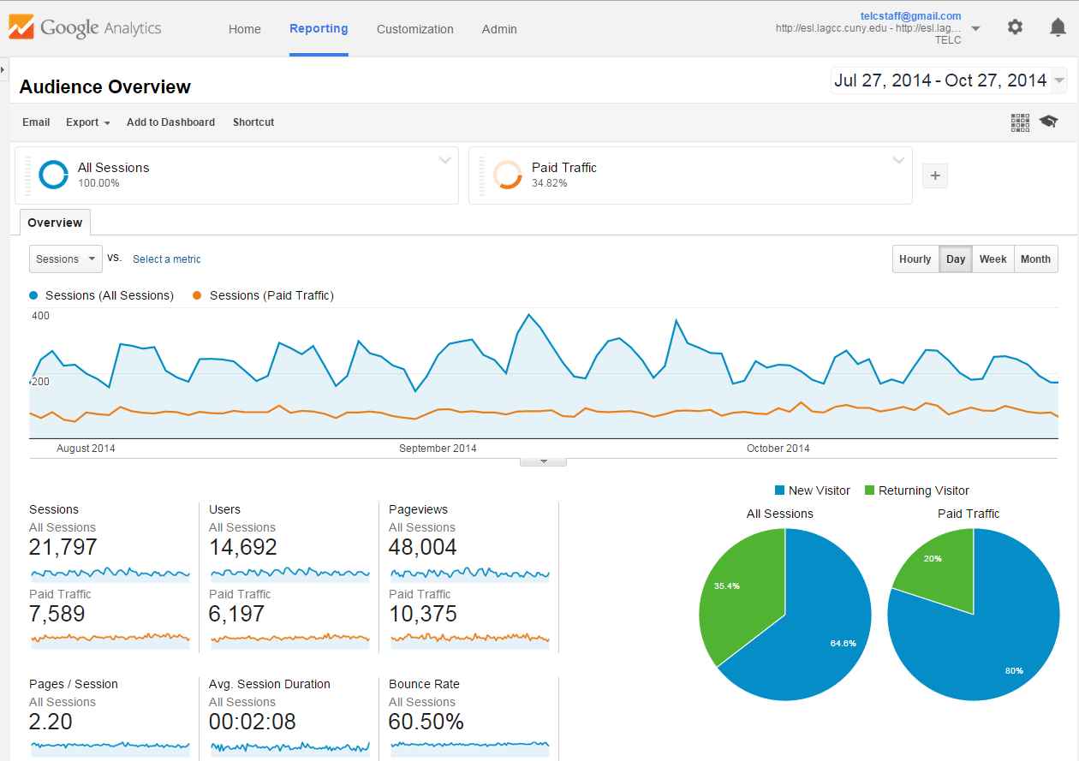

Slide 15
Campaign state | Campaign | Budget | Status | Campaign type | Clicks | Impressions | CTR | Avg. CPC | Cost | Avg. position
enabled | TELC Campaign OPT | 75 | campaign budget constrained | Search Only | 1419 | 77673 | 1.83% | 1.34 | 1,902.90 | 2.3
enabled | TELC - Visual | 7.5 | campaign budget constrained | Display Only | 950 | 105086 | 0.90% | 0.24 | 224.67 | 1
enabled | NYDesigns-lab | 50 | eligible | Search Only | 400 | 30077 | 1.33% | 2.19 | 876.02 | 3.5
paused | TELC Campaign | 75 | campaign paused | Search Only | 360 | 26948 | 1.34% | 1.17 | 422.57 | 2.6
enabled | CLEP | 8.69 | eligible | Search Only | 60 | 12400 | 0.48% | 1.28 | 76.76 | 3.9
enabled | 10000 Small Businesses - Opt | 30 | eligible | Search Only | 36 | 4053 | 0.89% | 2.27 | 81.88 | 4.2
enabled | Career and Professional Programs | 12 | eligible | Search Only | 2 | 217 | 0.92% | 0.95 | 1.9 | 9.3
Total - Display Network | -- | -- | -- | -- | 950 | 105086 | 0.90% | 0.24 | 224.67 | 1
Total - Search | -- | -- | -- | -- | 2277 | 151368 | 1.50% | 1.48 | 3,362.03 | 2.8
Total | -- | 461.19 | -- | -- | 3227 | 256454 | 1.26% | 1.11 | 3,586.70 | 2.1

Slide 16
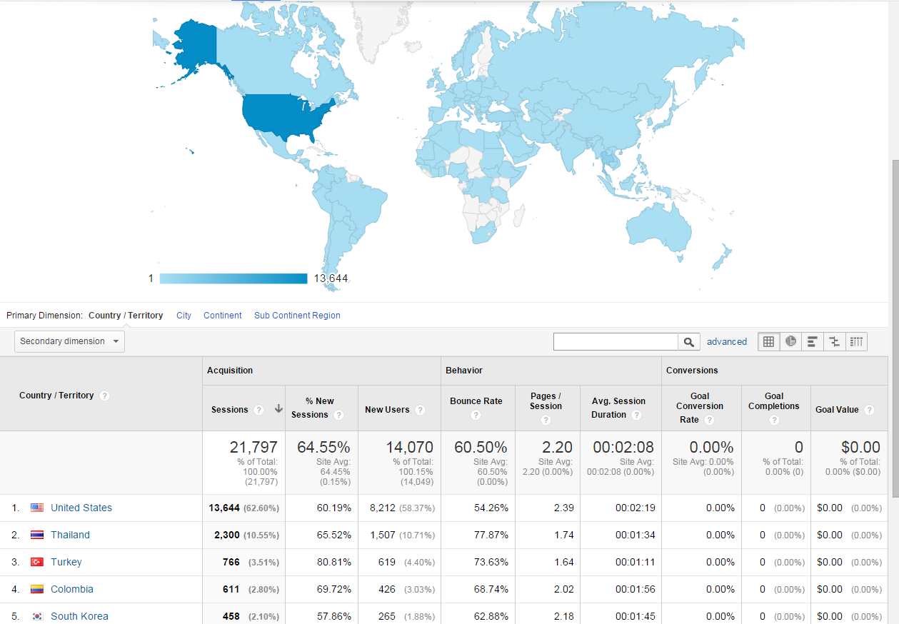

Slide 17
Day, evening, weekend classes, both full-time and part-time options
For college, workplace, or community
1148 students from 85 countries
Notes:
Let me tell you a bit about The English Language Center – then go through bullets.
I’m going to speak about our recruitment strategy on social media, and I’ll demonstrate the significance of the mobility of social media.
Our recruitment is global, so I am going to show you international, country-specific data. However, keep in mind that Facebook allows you to target and analyze by local town and neighborhood as well, and I’ll show you an example of that in a moment.

Slide 18
 | Where We Are From | Traffic To Website | Fans On Facebook | Views On YouTube
1 | Colombia | United States | South Korea | United States
2 | Ecuador | Thailand | United States | Thailand
3 | Thailand | Turkey | Thailand | Japan
4 | Mexico | Colombia | Colombia | Canada
5 | Poland | South Korea | Turkey | Turkey
6 | Turkey | Canada | Egypt | Colombia
7 | South Korea | Japan | Pakistan | Vietnam
8 | Dominican Republic | Brazil | Indonesia | South Korea
9 | China | Mexico | Algeria | Ecuador
10 | Peru | Ecuador | Ecuador | Egypt
11 | Brazil | China | Mexico | Brazil
12 | Bangladesh | Taiwan | Brazil | Mexico
13 | United States | Dominican Republic | Peru | Cambodia
14 | El Salvador | Egypt | Morocco | Poland
15 | Bolivia | Vietnam | Taiwan | Dominican Republic
16 | Egypt | Indonesia | Bangladesh | Indonesia
17 | Kazakhstan | Poland | Mauritania | Taiwan
18 | Paraguay | India | Japan | Laos
19 | Russia | Spain | Poland | Algeria
20 | Honduras | Pakistan | Tunisia | Morocco
Notes:
This data is from Fall 2014.
First column, country of origin. Some examples of common countries of origin with an open internet structure, growing or stable middle class, which translates to access.
South Korea – most connected in the world, Thailand – emerging middle class and strong internet structure

Slide 19
 | Where We Are From | Traffic To Website | Fans On Facebook | Views On YouTube
1 | Colombia | United States | South Korea | United States
2 | Ecuador | Thailand | United States | Thailand
3 | Thailand | Turkey | Thailand | Japan
4 | Mexico | Colombia | Colombia | Canada
5 | Poland | South Korea | Turkey | Turkey
6 | Turkey | Canada | Egypt | Colombia
7 | South Korea | Japan | Pakistan | Vietnam
8 | Dominican Republic | Brazil | Indonesia | South Korea
9 | China | Mexico | Algeria | Ecuador
10 | Peru | Ecuador | Ecuador | Egypt
11 | Brazil | China | Mexico | Brazil
12 | Bangladesh | Taiwan | Brazil | Mexico
13 | United States | Dominican Republic | Peru | Cambodia
14 | El Salvador | Egypt | Morocco | Poland
15 | Bolivia | Vietnam | Taiwan | Dominican Republic
16 | Egypt | Indonesia | Bangladesh | Indonesia
17 | Kazakhstan | Poland | Mauritania | Taiwan
18 | Paraguay | India | Japan | Laos
19 | Russia | Spain | Poland | Algeria
20 | Honduras | Pakistan | Tunisia | Morocco
Notes:
Social media ensures you are reaching places with web restrictions, and also, places where mobile use is more common than desktop. Social is mobile optimized!
Bangladesh enrollments are recent. Word of mouth facilitated by growth on Facebook. The power of the share.
After the Arab Spring beginning in late 2010, we saw a spike in traffic from these countries – and the enrollments followed shortly afterward. (Egypt).
Limit my talk to Facebook – but we have a presence on other platforms. Analytics on Facebook provide us with some useful insight.

Slide 20
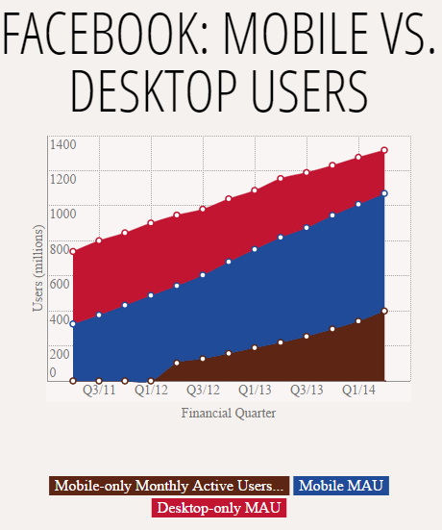
1.32 billion monthly users
77% of users access from mobile occasionally
30% of users are mobile-only
Source: The Verge, July 2014
Notes:
TELC Website:
Desktop 57% Mobile 43%
Facebook users are 78% on mobile! What does this mean?
Reach your audience where they are – on their phones!

Slide 21
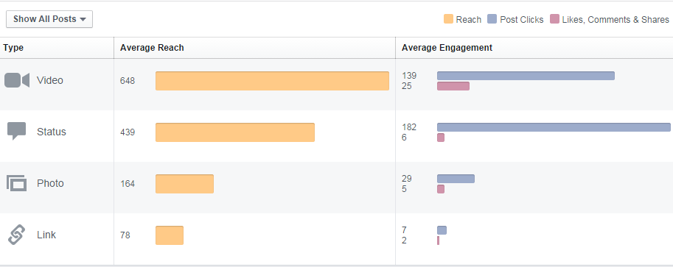
WHAT YOU POST MATTERS
Visual and interactive posts are better than text.
Notes:
Visual and interactive – not just text based. Use video and keep it short.

Slide 24
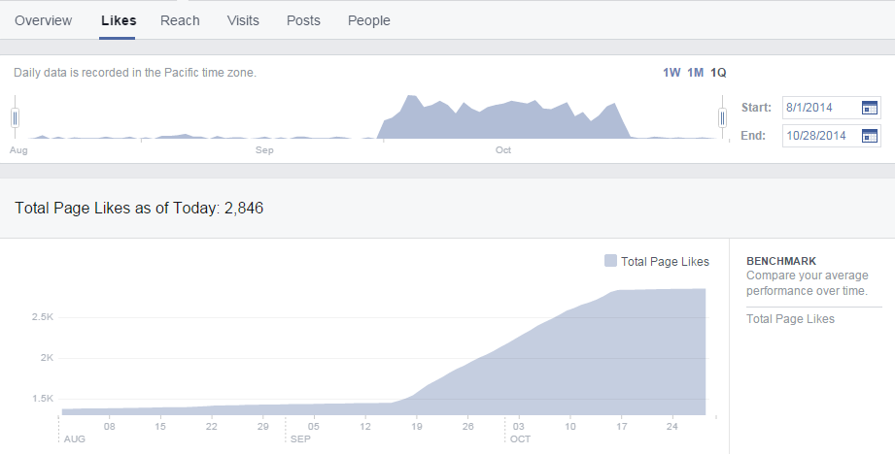
FACEBOOK Ads work
Target people based on their location and interests.
Notes:
Local targeting – we identified Facebook users within 10 miles of the school with their language set to Chinese, and we sent Chinese language ads to them.
Today’s postcard mailing, but much cheaper. Also, you only pay for people who opt in.
South Korean campaign: 1012 likes, $0.20/like (15,716 impressions, $0.01/impression)
Local Chinese campaign: 220 likes, $1.36/like (10,768 impressions, $0.03/impression)

Slide 25
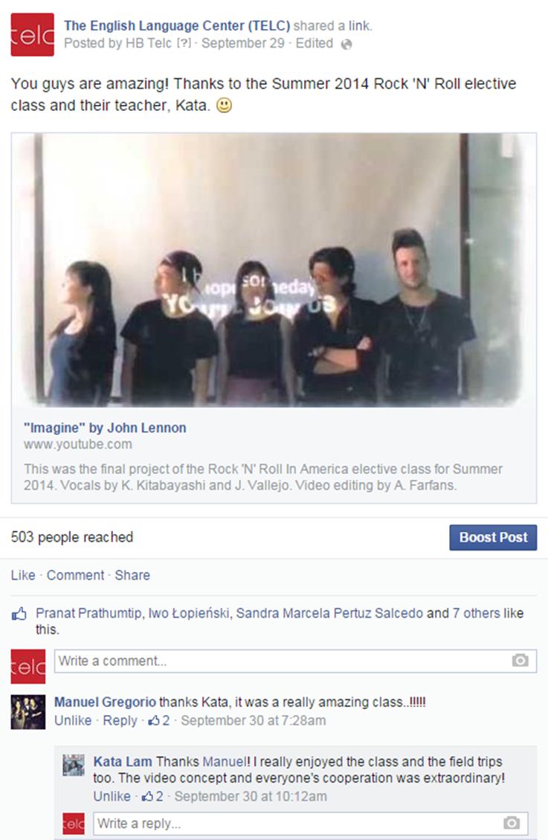
CONSIDER YOUR AUDIENCE
TELC reaches out to current and potential students who are:
college-bound.
pre-professional.
tech-savvy.
Notes:
Informal tone, emojis, showcasing of student work, cross-platform, encouraging dialog.

Slide 26
CONSIDER YOUR AUDIENCE
College & Career Pathways Institute reaches out to teachers and administrators who are:
professionals.
partners in the field.
Notes:
More formal tone, no abbreviations or emojis, highlighting the partner relationship.
Challenges of shifting tone for social media – taking press release language and hacking it down.

Slide 27
 | CHALLENGES | OPPORTUNITIES
Print: Catalog, fliers, postcards, brochures, print ads
Internet: E-blasts, website, Google AdWords
Social Media: Facebook, Twitter, Instagram, LinkedIn

Slide 28
QUESTIONS?

Slide 29
THANK YOU
Jane MacKillop jmackillop@lagcc.cuny.edu
Francesca Fiore ffiore@lagcc.cuny.edu
Heather Barikmo hbarikmo@lagcc.cuny.edu

